Slide 1
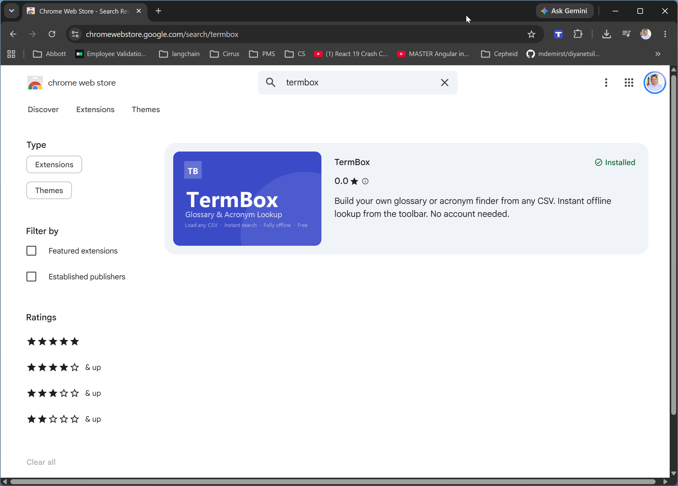
To install TermBox go to link https://chromewebstore.google.com/search/termbox and click on install

Slide 2
After installation TermBox icon will appear in the Extensions toolbar, click on it

Slide 3
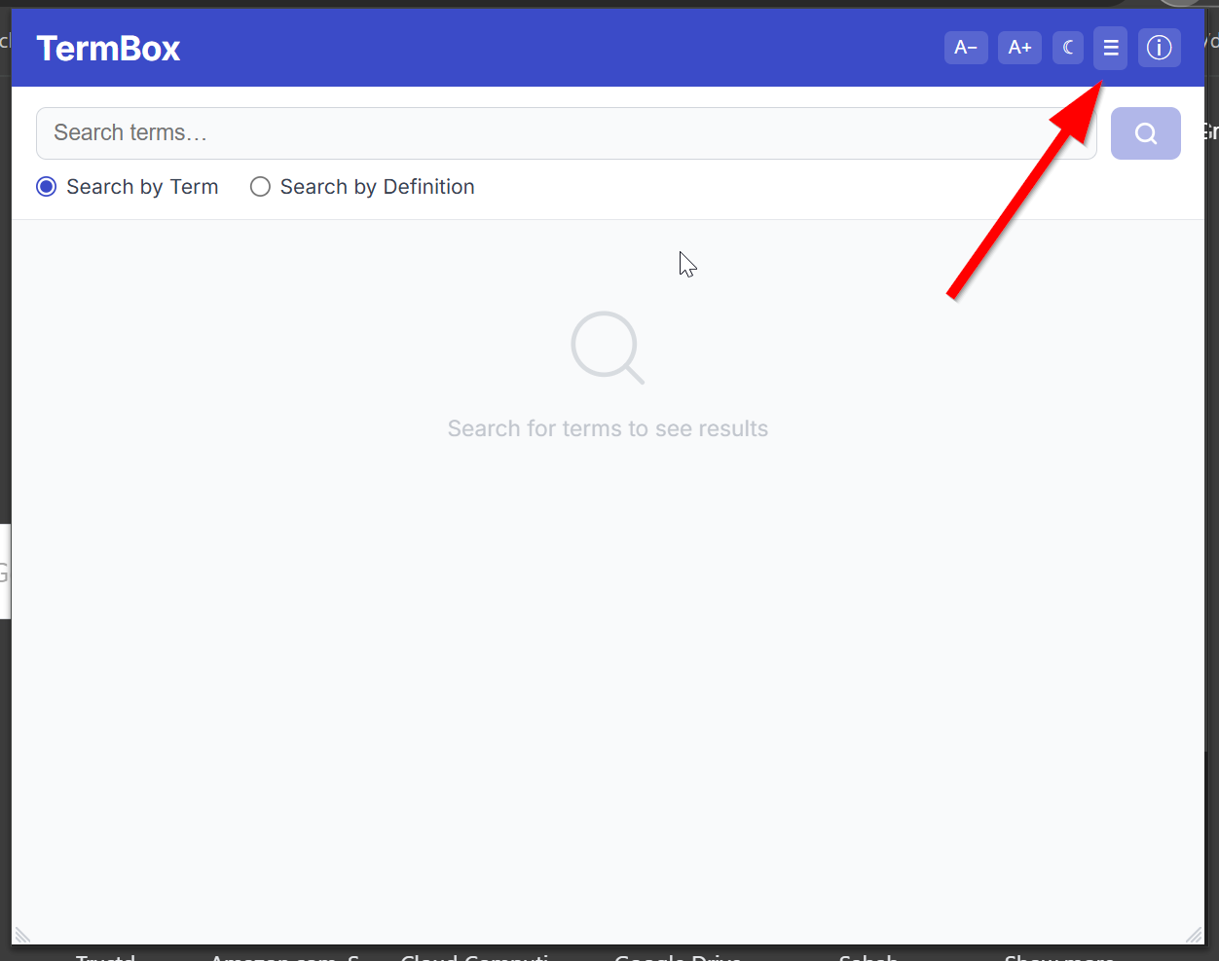
First time you open it, there might be no source loaded, click on the Manage Sources button

Slide 4
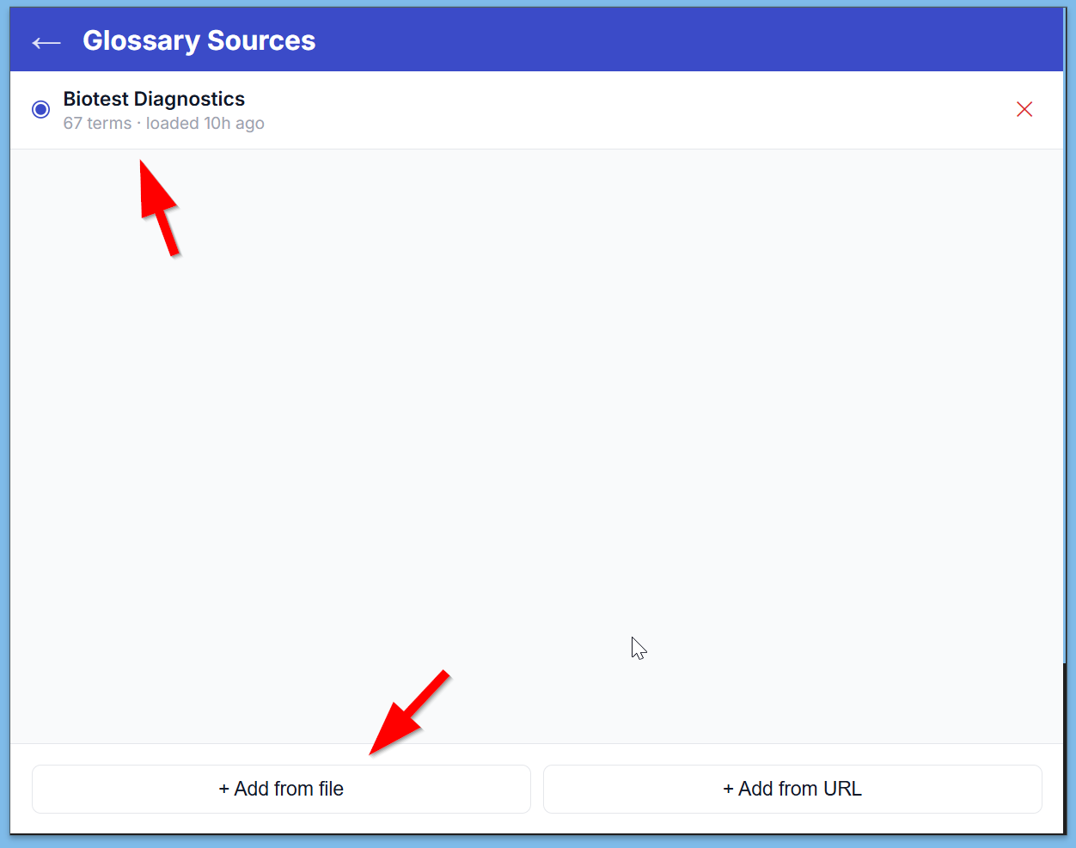
On Manage Sources screen, you can load a new file or you can choose a source file to use

Slide 5
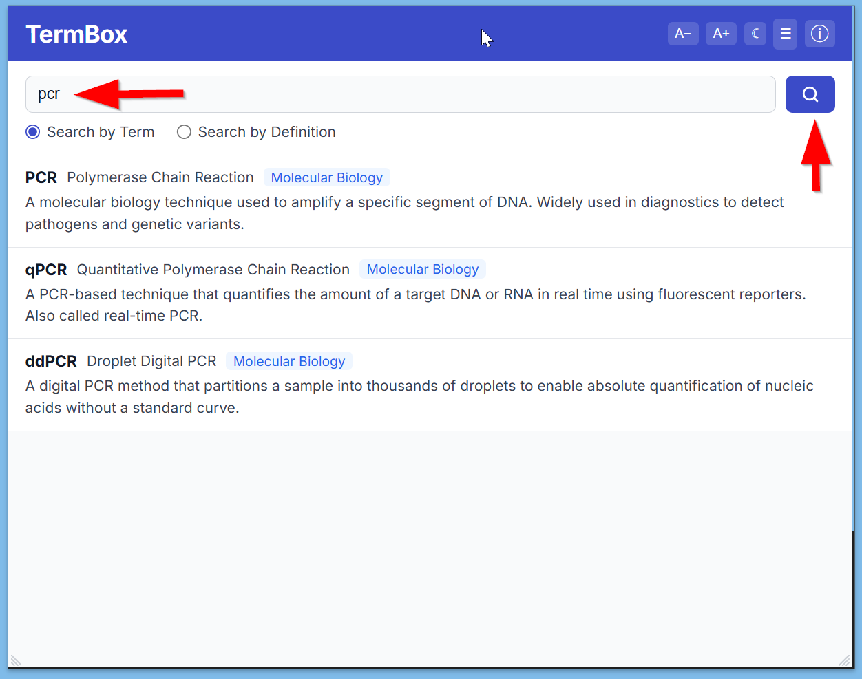
You can search for terms (acronyms) by term or definiton, by entering a text and clicking on the search button, results will display below

Slide 6
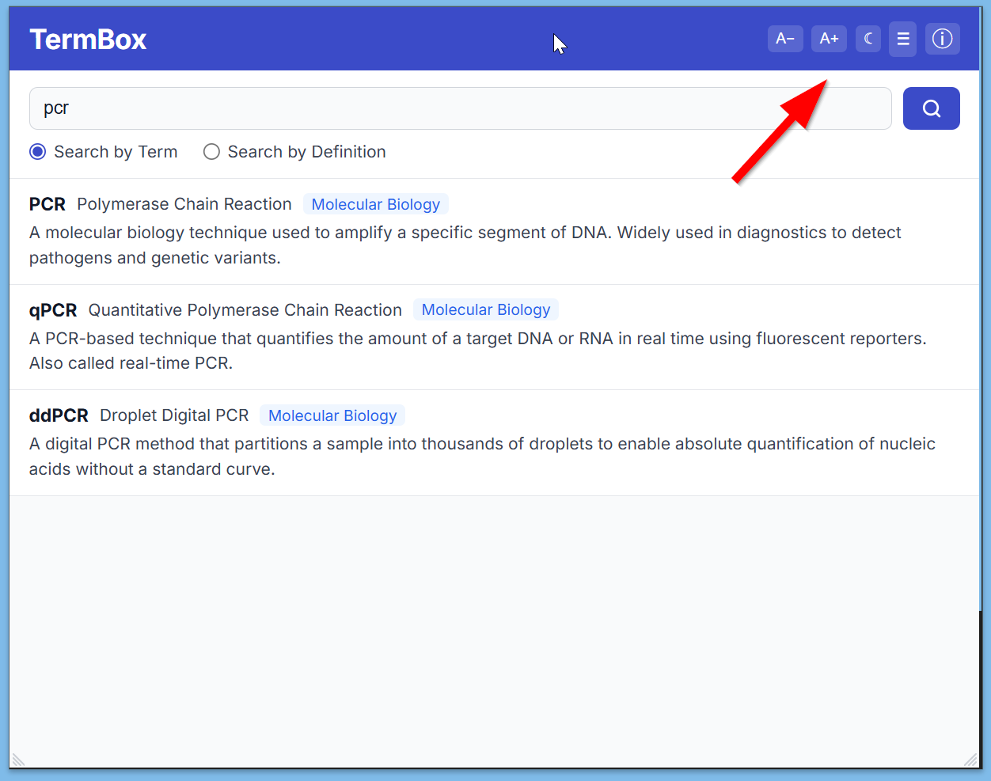
For your convenience you can change font size, and toggle dark / light mode

